Slide 1
C++ Programming Design
Session #8

Slide 2
#8 Operator overloading
Operator overloading
Overloading the << operator for output
Automatic conversions and type casts for classes
Class conversion constructors
Class conversion functions

Slide 3
#8 Operator overloading
Ease yourself into the language. Don’t feel you have to use all of the features, and don’t try to use them all on the first day.
Bjarne Stroustrup

Slide 4
Operator Overloading
(1)Let you assign multiple meanings to C++ operators.
(2)Actually, many C++ (and C) operators already are overloaded.
For example, the operator *.
C++ uses the number and type of operands to decide which action to take.

Slide 5
Operator Overloading
(3)C++ lets you extend operator overloading to user-defined types.
For example, to use the + symbol to add two objects.
The compiler uses the number and type of operands to determine which definition of addition to use.

Slide 6
Operator Overloading
(4)A kind of C++ polymorphism.
(5)Operator overloading is essentially function overloading.
(6)Overloaded operators can often make code look more natural.

Slide 7
Operator Overloading: Implementation
To overload an operator, you use a special function form called an operator function, whose form is
returntype operatorop(argument-list) //op is a operator
Examples:
operator+(…) overloads the + operator
operator*(…) overloads the * operator
The op has to be a valid C++ operator; you can’t just make up a new symbol.

Slide 8
Operator Overloading: An example
For example of a Salesperson class, define an operator+() member function to overload the + operator so that it adds sales figures of one salesperson object to another.
Then, if district2, sid, and sara are all objects of the Salesperson class, we can write this equation:
district2 = sid + sara;
The compiler, recognizing the operands as belonging to the Salesperson class, replaces the operator with the corresponding operator function:
district2 = sid.operator+(sara);

Slide 9
Time on Our Hands: Developing an Operator Overloading Example
class Time
{
private:
int hours;
int minutes;
public:
Time();
Time(int h, int m = 0);
void AddMin(int m);
void AddHr(int h);
void Reset(int h = 0, int m = 0);
void Show() const;
Time Sum(const Time & t) const;
};

Slide 10
Time on Our Hands: Developing an Operator Overloading Example
Time Time::Sum(const Time & t) const
{
Time sum;
sum.minutes = minutes + t.minutes;
sum.hours = hours + t.hours + sum.minutes / 60;
sum.minutes %= 60;
return sum;
}

Slide 11
Time on Our Hands: Adding an Addition Operator
class Time
{
private:
int hours;
int minutes;
public:
Time();
Time(int h, int m = 0);
void AddMin(int m);
void AddHr(int h);
void Reset(int h = 0, int m = 0);
void Show() const;
Time Sum(const Time & t) const;//OLD
};

Slide 12
Time on Our Hands: Adding an Addition Operator
class Time
{
private:
int hours;
int minutes;
public:
Time();
Time(int h, int m = 0);
void AddMin(int m);
void AddHr(int h);
void Reset(int h = 0, int m = 0);
void Show() const;
Time operator+(const Time & t) const;//NEW
};

Slide 13
Time on Our Hands: Adding an Addition Operator
Time operator+(const Time & t) const
{
Time sum;
sum.minutes = minutes + t.minutes;
sum.hours = hours + t.hours + sum.minutes / 60;
sum.minutes %= 60;
return sum;
}

Slide 14
Time on Our Hands: Adding an Addition Operator
int main()
{
Time coding(2, 40);
Time fixing(5, 55);
Time morefixing;
Time total;
total = coding + fixing; // operator overloading notation
cout << "coding + fixing = ";
total.Show();
cout << endl;
total = morefixing.operator+(total); // function overloading notation
cout << "morefixing.operator+(total) = ";
total.Show();
cout << endl;
return 0;
}

Slide 15
Time on Our Hands: Adding an Addition Operator
int main()
{
Time t1, t2, t3, t4;
t4 = t1 + t2 + t3;
return 0;
}
//Valid?

Slide 16
Time on Our Hands: Adding an Addition Operator
t4 = t1 + t2 + t3;
t4 = t1.operator+(t2 + t3);
t4 = t1.operator+(t2.operator+(t3));

Slide 17
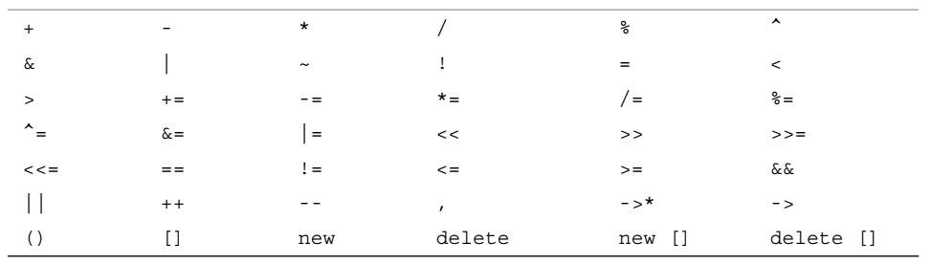
Overloading Restrictions
Most C++ operators can be overloaded.
Table 8.1

Slide 18
Overloading Restrictions
(1)The overloaded operator must have at least one operand that is a user-defined type.
This prevents you from overloading operators for the standard types.
For example, you can’t redefine the minus operator (-) so that it yields the sum of two double values instead of their difference.

Slide 19
Overloading Restrictions
(2)You can’t use an operator in a manner that violates the syntax rules for the original operator.
For example, you can’t overload % so that it can be used with a single operand:
int x; % x;
Time shiva; % shiva;
Similarly, you can’t alter operator precedence.
So if you overload the addition operator to let you add two classes, the new operator has the same precedence as ordinary addition.

Slide 20
Overloading Restrictions
(3) You can’t create new operator symbols.
For example, you can’t define an operator**() function to denote exponentiation.

Slide 21
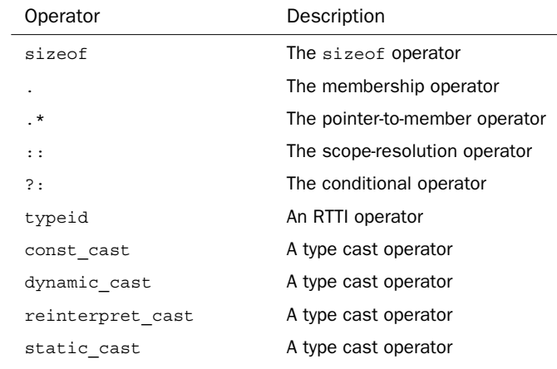
Overloading Restrictions
(4)You cannot overload the following operators:

Slide 22
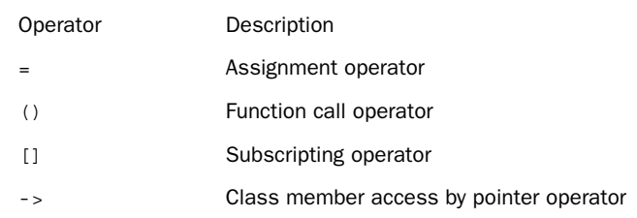
Overloading Restrictions
(5) Most of the operators in Table 8.1 can be overloaded by using either member or nonmember functions.
However, you can use only member functions to overload the following operators:
Notes:
Array A(n);
A[i];
A->I;
A(i);

Slide 23
Overloading Restrictions
(6) In addition to these formal restrictions, you should use sensible restraint in overloading operators.
For example, you shouldn’t overload the * operator so that it swaps the data members of two Time objects.
Nothing in the notation would suggest what the operator did, so it would be better to define a class method with an explanatory name such as Swap().

Slide 24
Overloaded Operators: Member Versus Nonmember Functions
For many operators, you have a choice between using member functions or nonmember functions to implement operator overloading.
Typically, the nonmember version is a friend function so that it can directly access the private data for a class.

Slide 25
Overloaded Operators: Member Versus Nonmember Functions
For example, consider the + operator for the Time class:
A) Class member declaration:
Time operator+(const Time & t) const;
B) Nonmember friend function declaration:
friend Time operator+(const Time & t1, const Time & t2);
NOTE: A member version of the same operator requires one fewer parameter because one operand is passed implicitly as the invoking object.

Slide 26
Overloaded Operators: Member Versus Nonmember Functions
The compiler can convert the statement
T1 = T2 + T3;
to either of the following:
T1 = T2.operator+(T3); // member function
T1 = operator+(T2, T3); // nonmember function
NOTE: Keep in mind that you must choose one or the other form when defining a given operator, but not both.
Which form, then, is it best to use?

Slide 27
Overloaded Operators: << and >>
NOTE:
(1)To overload operators << and >>, it must be declared as nonmember friend function。
(2) Function type must be a reference of ostream/istream object, that is, ostream & or istream &。
ostream & operateor << (ostream &,user-defined class);
istream & operateor >> (istream &, user-defined class);

Slide 28
Overloaded Operators: << and >>
ostream& operator<<(ostream &out, Time &t)
{ out << t.hours << "hours," << t.minutes << "minutes";
return out;
}
istream& operator>>(istream &in, Time &t)
{ cout << "Input hours and minutes:";
in >> t.hours >> t.minutes;
return in;
}
int main( )
{ Time t1, t2, t3;
cin >> t1 >> t2;
cout << "t1 = " << t1 << "\n";
t3 = t1 + t2;
cout << "t3 = t1 + t2 = " << t3 << "\n";
return 0;
}

Slide 29
Automatic Conversions and Type Casts for Classes
C++ makes many type conversions automatically:
long count = 8;
double time = 11;
int side = 3.33;

Slide 30
Automatic Conversions and Type Casts for Classes
C++ automatic conversions happen when
(1)C++ converts values when you assign a value of one arithmetic type to a variable of another arithmetic type.
(2) C++ converts values when you combine mixed types in expressions.
(3)C++ converts values when you pass arguments to functions.

Slide 31
Automatic Conversions and Type Casts for Classes
C++ also allows explicit type conversion, that is, type cast.
int thorn=1;
(long) thorn //From C
long (thorn) // New C++

Slide 32
Automatic Conversions and Type Casts for Classes
C++ allows to define a class sufficiently related to a basic type or to another class that it makes sense to convert from one form to another.
In such a case, you can tell C++ how to make such conversions automatically or via a type cast.

Slide 33
Automatic Conversions and Type Casts for Classes
C++ provides the two kinds of type conversions for classes:
(1) A class conversion constructor that has but a single argument serves as an instruction for converting a value of the argument type to the class type.
(2) A special class member operator function called a conversion function serves as an instruction for converting a class object to some other type.

Slide 34
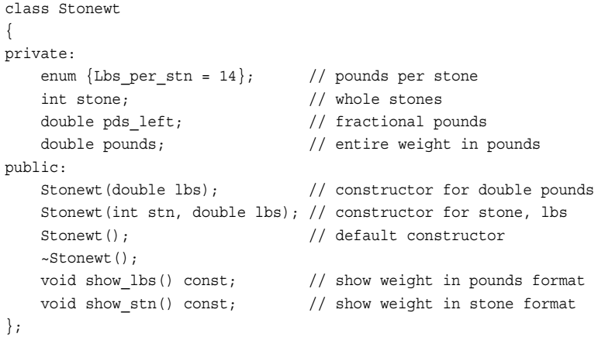
Automatic Conversions and Type Casts for Classes

Slide 35

Automatic Conversions and Type Casts for Classes

Slide 36

Automatic Conversions and Type Casts for Classes
?

Slide 37
Automatic Conversions and Type Casts for Classes

Slide 38
Automatic Conversions and Type Casts for Classes: Conversion constructor
In C++, any constructor that takes only a single argument acts as a blueprint for converting a value of that argument type to the class type, that is, conversion constructor.

Slide 39
Automatic Conversions and Type Casts for Classes: Conversion constructor
Only a constructor with just one argument works as a conversion, thus
Stonewt(int stn, double lbs);
//not a conversion constructor.
However, it would act as a guide to int conversion if it provided a default value for the second parameter:
Stonewt(int stn, double lbs = 0);
//is int-to-Stonewt conversion.

Slide 40
Automatic Conversions and Type Casts for Classes: Conversion constructor
(1)The program uses the Stonewt(double) constructor to construct a temporary Stonewt object, using 19.6 as the initialization value.
(2)Then memberwise assignment copies the contents of the temporary object into myCat.
Implicit conversion

Slide 41
Automatic Conversions and Type Casts for Classes: Conversion constructor
When implicit conversion happened?
(1)When you initialize a Stonewt object to a double value;
(2)When you assign a double value to a Stonewt object;
(3)When you pass a double value to a function that expects a Stonewt argument;
(4)When a function that’s declared to return a Stonewt value tries to return a double value.

Slide 42
Automatic Conversions and Type Casts for Classes: Conversion constructor
When implicit conversion happened?
(5)When any of the preceding situations use a built-in type that can unambiguously be converted to type double
For example:
Stonewt Jumbo(7000); // uses Stonewt(double)
Jumbo = 7300; // uses Stonewt(double)
NOTE: This conversion process works only if there is an unambiguous choice.
That is, if the class also defined a Stonewt(long) constructor, the compiler would reject these statements.

Slide 43
Automatic Conversions and Type Casts for Classes: Conversion constructor
C++ added a new keyword, explicit, to turn off the automatic conversions and turn on explicit type casts.
For example, you can declare the constructor as :
explicit Stonewt(double lbs);
Using explicit type casts:
Stonewt myCat;
myCat = 19.6;
mycat = Stonewt(19.6);
mycat = (Stonewt) 19.6;

Slide 44

Automatic Conversions and Type Casts for Classes: Conversion function
Conversion constructor
Conversion function

Slide 45
Automatic Conversions and Type Casts for Classes: Conversion function
To convert to type typeName, you use a conversion function in the following form:
operator typeName();
For example:
operator double();
Note the following points:
(1)The conversion function must be a class method.
(2)The conversion function must not specify a return type.
(3)The conversion function must have no arguments.

Slide 46
Automatic Conversions and Type Casts for Classes: Conversion function
class Stonewt
{
private:
enum {Lbs_per_stn = 14}; // pounds per stone
int stone; // whole stones
double pds_left; // fractional pounds
double pounds; // entire weight in pounds
public:
Stonewt(double lbs); // construct from double pounds
Stonewt(int stn, double lbs); // construct from stone, lbs
Stonewt(); // default constructor
~Stonewt();
// conversion functions
operator int() const;
operator double() const;
};

Slide 47
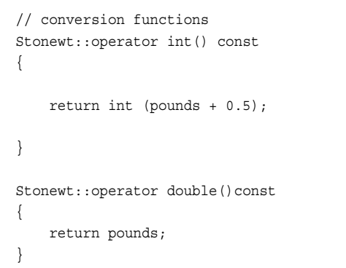
Automatic Conversions and Type Casts for Classes: Conversion function

Slide 48
Automatic Conversions and Type Casts for Classes: Conversion function
For conversion function, you can use explicit conversion, that is, type cast:
Stonewt wolfe(285.7);
double host = double (wolfe); // From C
double thinker = (double) wolfe; // New C++

Slide 49
Automatic Conversions and Type Casts for Classes: Conversion function
And you can also use implicit conversion, that is, automatic type conversion:
Stonewt wells(20, 3);
int star = wells;
But for the following statement:
long gone = wells; //ambiguous
In this case, you can use an explicit type cast to indicate which conversion function to use.
long gone = (double) wells; // use double conversion
long gone = int (wells); // use int conversion

Slide 50
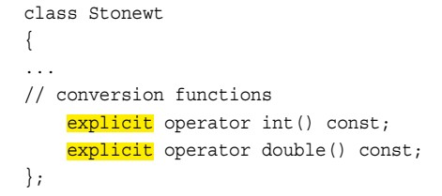
Automatic Conversions and Type Casts for Classes: Conversion function
In C++98, the keyword explicit doesn’t work with conversion functions, but C++11 removes that limitation.
With C++11, you can declare a conversion operator as explicit:

Slide 51
Conversions and Operator Overloading
int main()
{ Rational r1(3,5), r2, r3;
int n=3;
r2=r1+n;
return 0;
}
class Rational
{ public:
Rational();
Rational(int x,int y);
Rational(int x) { num=x; den=1; } //conversion constructor
friend Rational operator+(Rational a, Rational b);
private:
int num, den;
};

Slide 52
Conversions and Operator Overloading
int main()
{ Rational r1(3,5), r2, r3;
int n=3;
r2=r1+n;
return 0;
}
class Rational
{ public:
Rational();
Rational(int x,int y);
operator int() { return num;} //conversion function
Rational(int x) { num=x; den=1; } //conversion constructor
friend Rational operator+(Rational a, Rational b);
private:
int num, den;
};
//ambiguous

Slide 53
Conversion Summary
built-in → built-in: System conversions
built-in → user-defined: Conversion constructor
user-defined → built-in: Conversion function
user-defined → user-defined:
conversion function/constructor
class Teacher
{ public:
Teacher (Student &s);
operator Student ( );
};
//constructor
//conversion function

Slide 54
Programming Exercises
6.2 Rewrite the Stonewt class so that it overloads all six relational operators(>,<,==,!=,<=,>=). The operators should compare the pounds members and return a type bool value. Write a program that declares an array of six Stonewt objects and initializes the first three objects in the array declaration. Then it should use a loop to input values to set the remaining three array elements.

Slide 55
Programming Exercises
6.2 Continued:
Then it should report the smallest element, the largest element, and how many elements are greater or equal to 11 stone. (Tip: The simplest approach is to create a Stonewt object initialized to 11 stone and to compare the other objects with that object. Can you provide another method?)

